Slide 1

IN-SILICO IDENTIFICATION AND FUNCTIONAL CHARACTERIZATION
OF A TARGET PROTEIN USING SEQUENCE ANALYSIS AND HOMOLOGY-BASED ANNOTATION
BIOINFORMATICS PIPE LINE PROJECT
In-silico Identification and Functional Characterization of a Target Gene/Protein Using Sequence Analysis and Homology-Based Annotation

Slide 2

STEPS IN THE BIOINFORMATICS PIPE LINE PROJECT
1. Sequence retrieval
2.Sequence quality analysis
3.Sequence filtering and validation
4.Homology search (BLAST)
5.Functional annotation
6.Biological interpretation

Slide 3
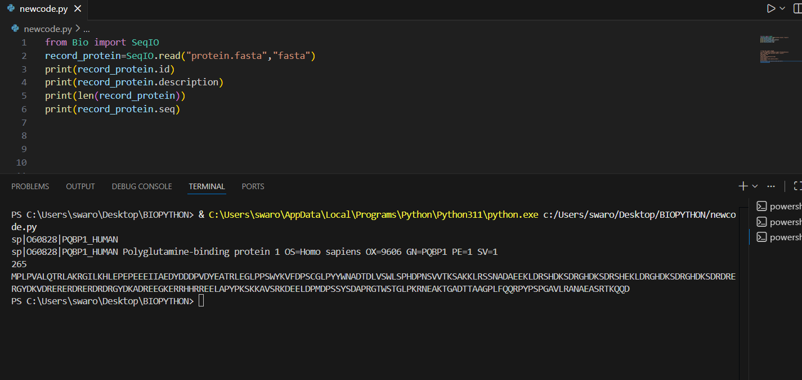
BIOLOGICAL SEQUENCE SELECTION
For this project a Disease-related protein is selected.
The hypothetical protein is taken for the uniport data base.
The sequence of interest (HTT PROTEIN) is linked to Huntington’s disease.
The sequence of interest for uniport data base is downloaded in the form of the FASTA File format.

Slide 4
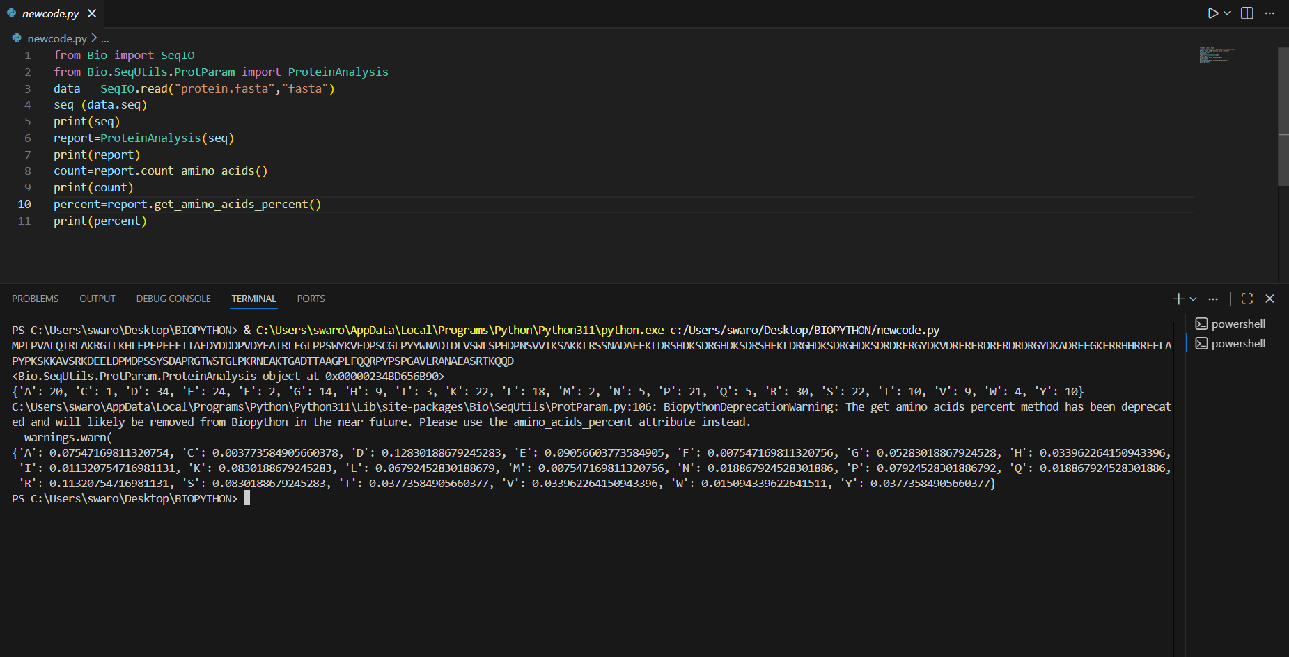
SEQUENCE QUALITY AND BASIC ANALYSIS
The Bio python is used for the sequences quality and basic analysis.
From uniport the fasta-format file is imported to Bio python through “SeqIO”.
Here - Length, amino acid composition(count) and percentage are calculated.

Slide 5
SEQUENCES FLITERING AND VALIDATION
The retrieved HTT protein sequence was validated by checking its source database (uniport) sequence length and fasta format correctness . The sequence contained only standard amino acids and showed no ambiguous resides ,confirming its suitability for down stream and bioinformatics analysis .

Slide 6
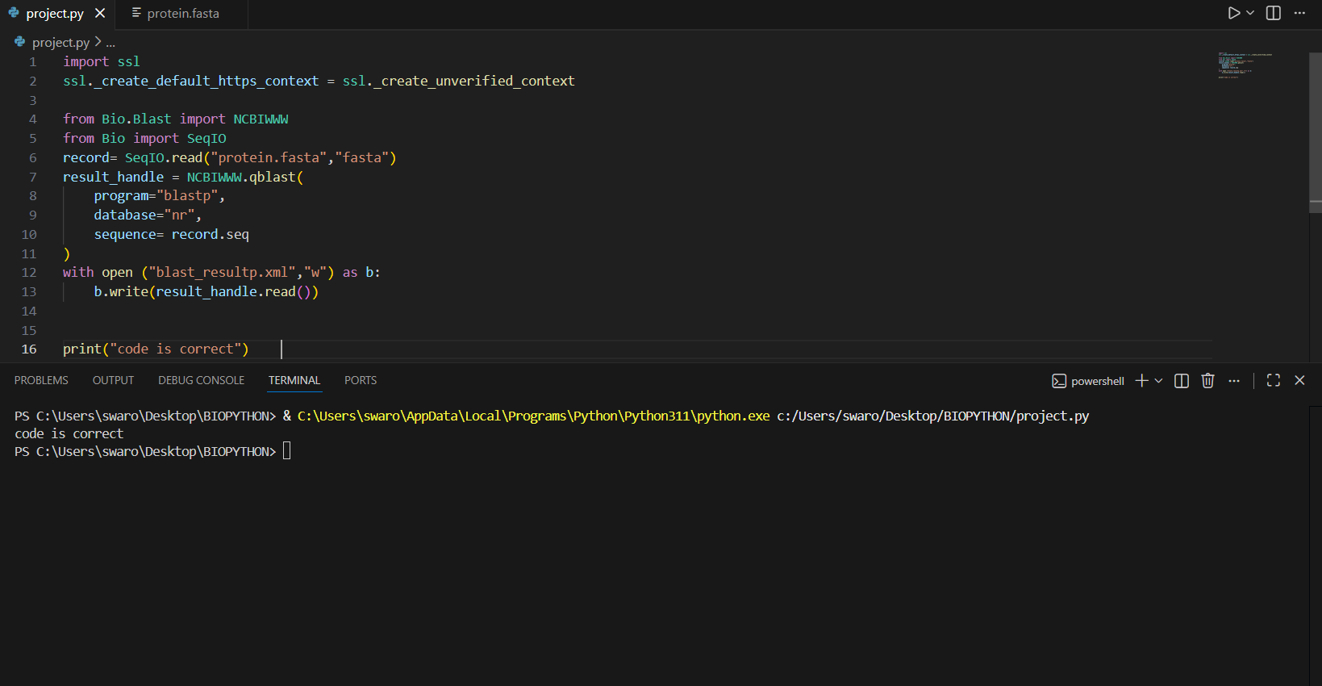
HOMOLOGY SEARCH
BLAST compares our HTT sequence with other sequences in the NCBI database to find similar proteins through NCBIWWW module.
We use-
The blast-p – protein vs protein comparison .
NCBI online Blast –Bio-python .

Slide 7
FUNCTIONAL ANNOTATION
By using blast ,a xml format file created from the code to perform the annotation, the similar sequences are obtained and in which contains the alignments , “hsp” of our HTT protein, Hits and e – value.
The closest sequence is: The hit with highest identity.
Lowest E value .
High score.
Usually : 1.chimpanzee HTT , 2.Mouse HTT , 2.Rat HTT.
These indicates strong evolutionary conservation.
The conserved regions are parts of the sequence –change very little over evolution , indicates important functional domains.
Close species –high similarity.
Distant species – lower similarity.
This helps in phylogenetic understanding.

Slide 8
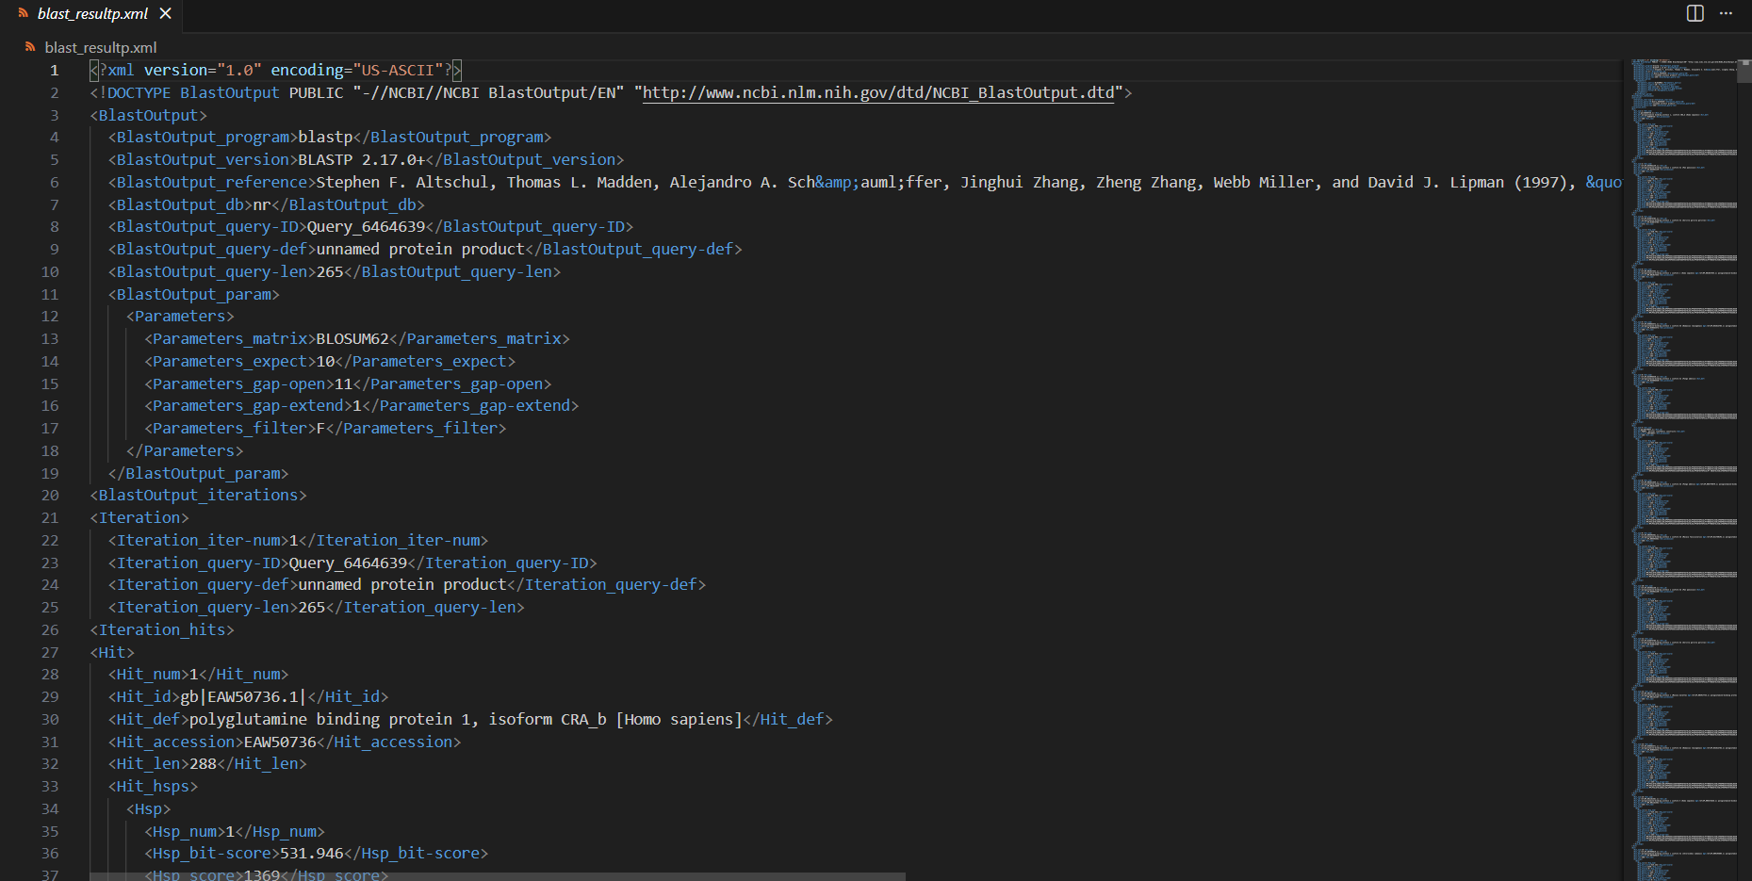
There are 50 alignments from blast.xml file.

Slide 9

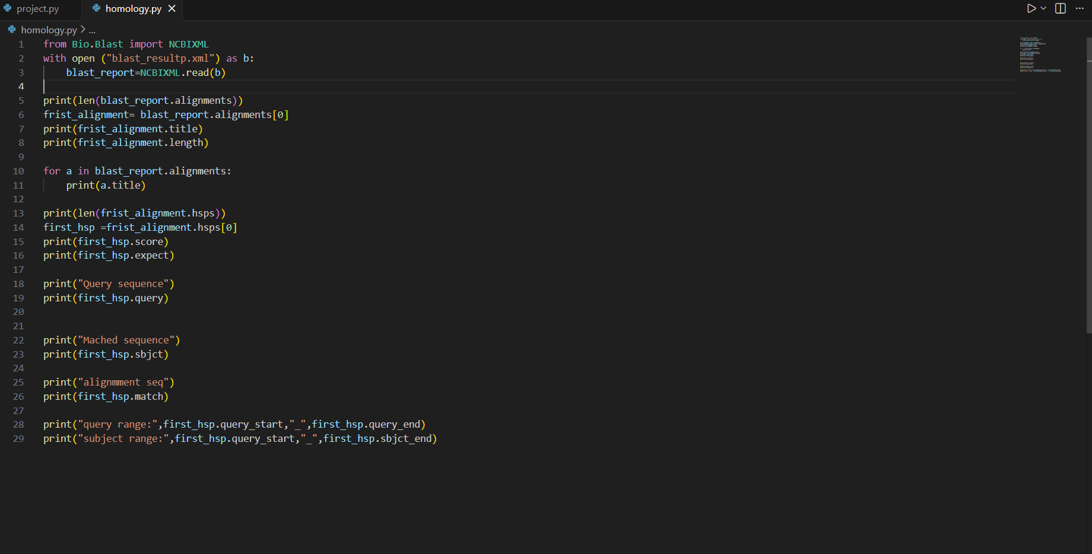
From the blast.xml file by using NCBIXML module the title, length of first alignment.
First HSP is printed which represents the high-scoring segment pair .

Slide 10
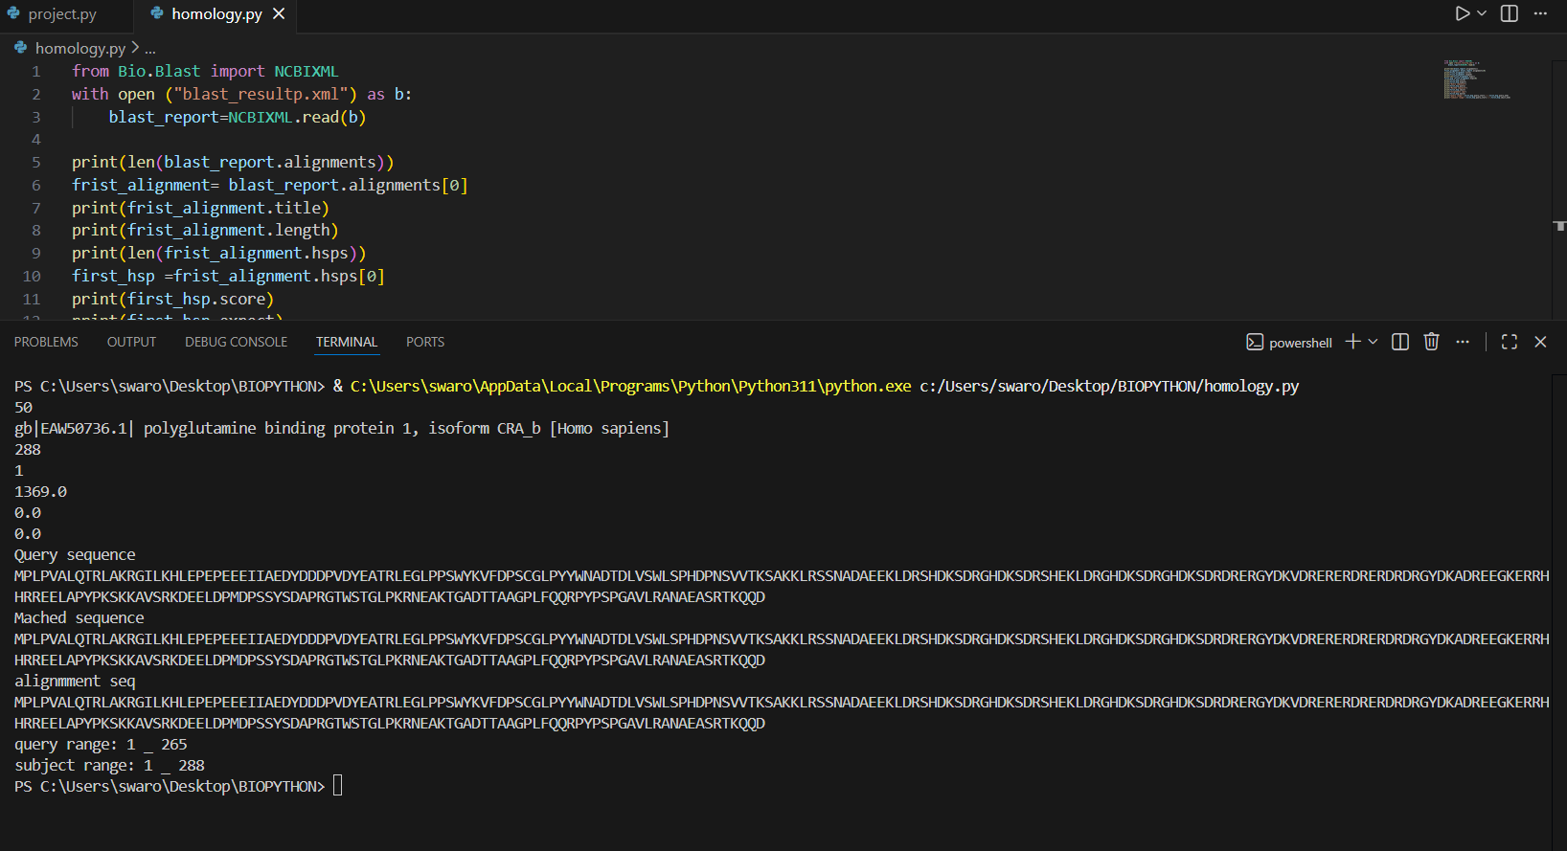
QUERY SEQUENCES , MACHED SEQUENCES AND ALIGNMENT SEQ are printed .

Slide 11
BIOLOGICAL INTERPRETATION
What does this sequence likely do?
This sequence codes for the Huntingtin protein, which is important for neuron survival, brain development, and cellular transport.
Why they it so?
We think this because BLAST showed it matches known Huntingtin proteins that are already studied in neuroscience.
Evidences support ….
Evidence supporting this interpretation includes:
1.High sequence similarity with validated Huntingtin proteins .
2.Very low BLAST E-values (close to 0.0), indicating true homology.
3.Conserved regions across mammals, suggesting functional importance.
4.UniProt and NCBI annotations linking HTT to neuronal processes and Huntington’s disease.

Slide 12
CONCULSION
Therefore, the analyzed sequence is confidently identified as Huntingtin protein, with a biological role in neuronal health and disease Research. Its conservation across species highlights its essential cellular function and evolutionary importance.

Slide 13
THANK YOU

